Slide 1
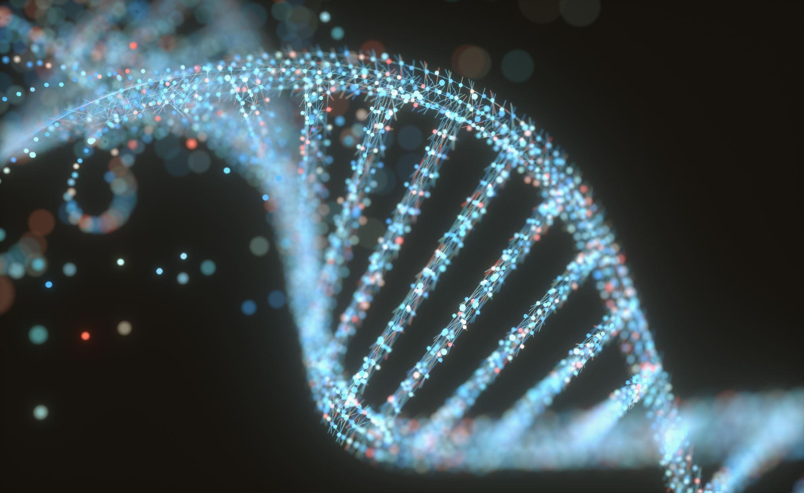
Genomic Analysis of Ovarian Cancer
Adassa Coimin, Daniela Villalva, Dunia Hamed, Vince Duarte
Team 4

Slide 2
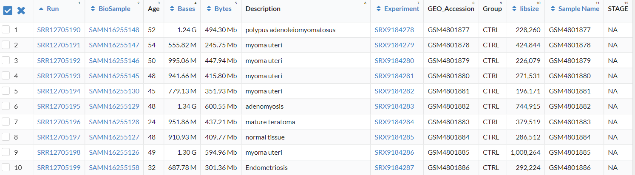
Introduction
RNA-sequenced data of tumor-educated platelets in ovarian cancer
69 samples
Liquid biopsies were used to obtain tumor-educated platelets
Notes:
Liquid biopsies are less invasive and are less harmful to the patient. Blood is often used as the liquid
Tumor educated platelets are modified by the tumor in multiple ways and act as a carrier and protector of metastasis
metastasis - the development of secondary malignant growths at a distance from a primary site of cancer.

Slide 3
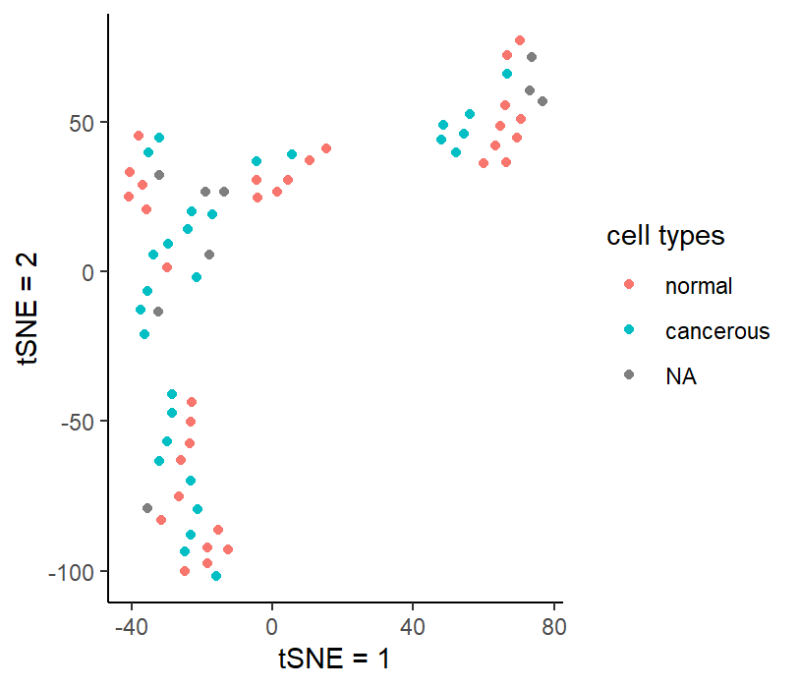
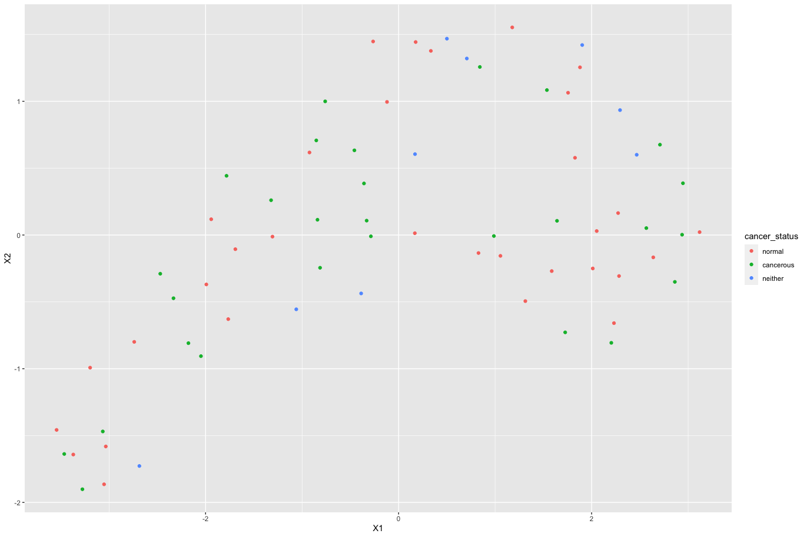
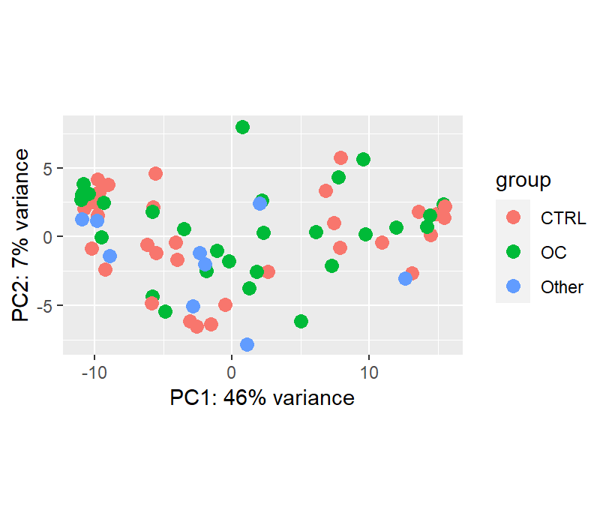
t-SNE and UMAP plots
t-SNE
UMAP
PCA plot
Organized by cancer status
More sparse data due to liquid biopsies
Notes:
When conducting these plots, we had to manually organize the data by their cancer status. From this data we can recognize that although a gene holds the same cancer status another gene, different factors play a role and create variance within the set of cancerous genes. In column -10 holds a dense amount of non-cancerous genes, allowing us to recognize that non-cancerous genes have less variation than cancerous genes.
blood samples-> more sparse data
This UMAP plot displays differently from the t-SNE and the PCA Plot in the fact that there seems to be more randomness and scatterness to the data points in it, relating to the cancer status of the samples in the dataset. This UMAP procedure was performed on normalized counts and took the data from thousands of genes and reduced to two variables X1 and X2.

Slide 4
Hypothesis
Question: Is it possible to identify the presence of ovarian cancer in blood platelets based on gene expression?
Hypothesis: Gene expression can be used to identify the presence of ovarian cancer in blood platelets.
Inspiration: We drew inspiration from an experiment that used an image-based deep learning approach combined with biological knowledge to classify a small set of human samples. With their advanced technology, it is easier for them to contrast between cancerous and non-cancerous genes. So, our team pondered on whether the sequence data themselves can represent their cancer status in a much more elementary fashion.
Notes:
Explanation for how and why the hypothesis was chosen.
harder to
showed the positives and not the negatives in vP

Slide 5
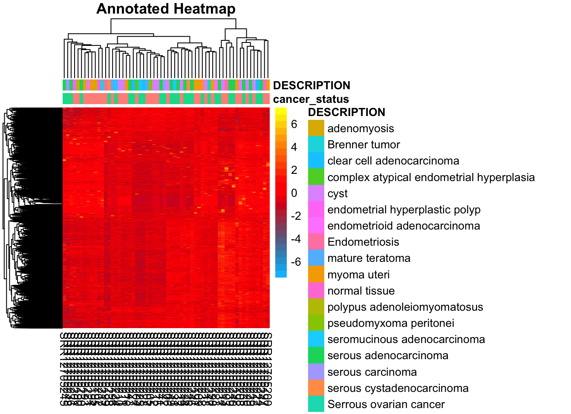
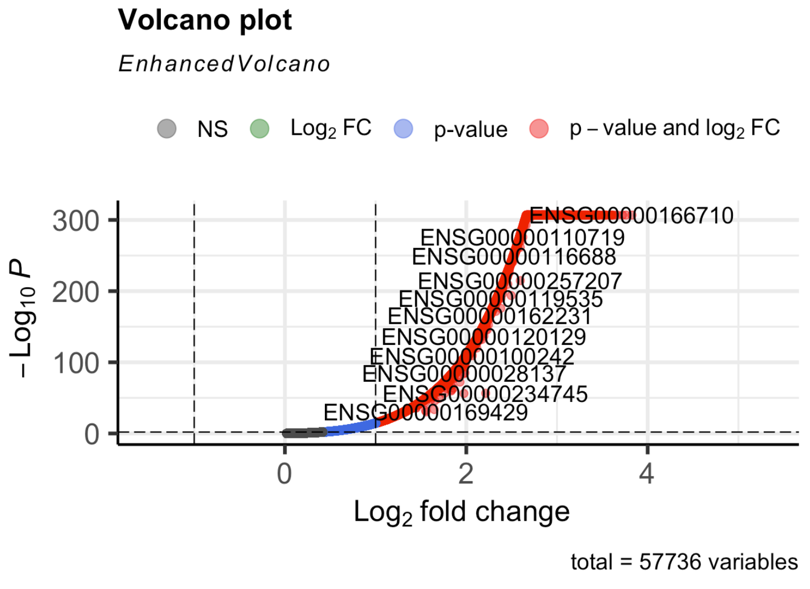
Differential Expression
Notes:
used only the positive values from the log fold change
may have used the counts data instead

Slide 6
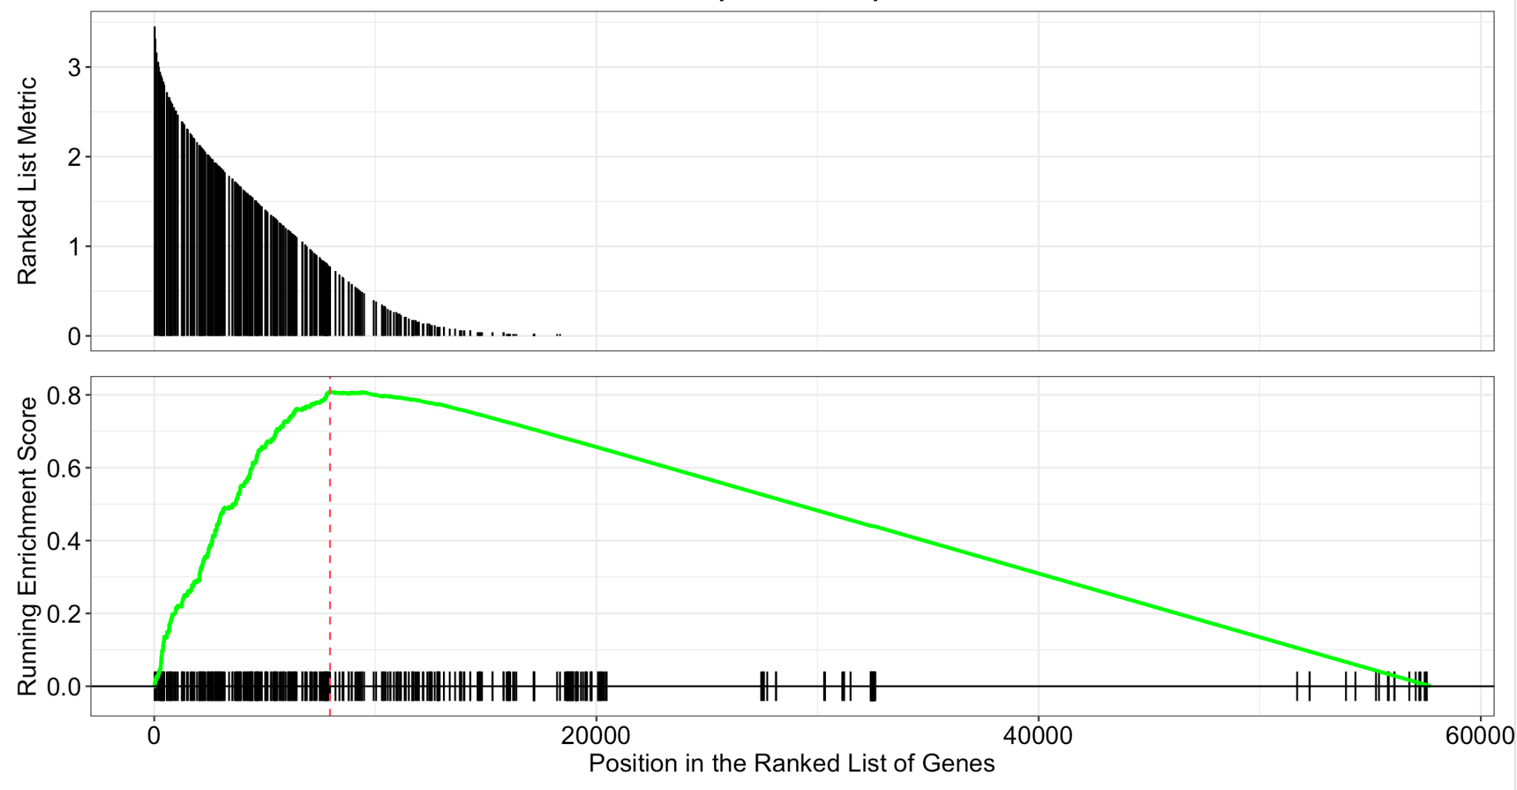
Gene Set Enrichment Analysis (GSEA)
Notes:
This plot shows the manner in which the gene set from our dataset is distributed along with the enrichment score, and ranked position of the genes. This plot again takes the results from the enrichment analysis performed by gene ontology and displays the relevant information regarding the genes. Our plot is particularly interesting due to the way in which we have a high enrichment score, across the board, while all of our genes seem to be positively expressed. This ideally probably shouldn’t be the case.

Slide 7
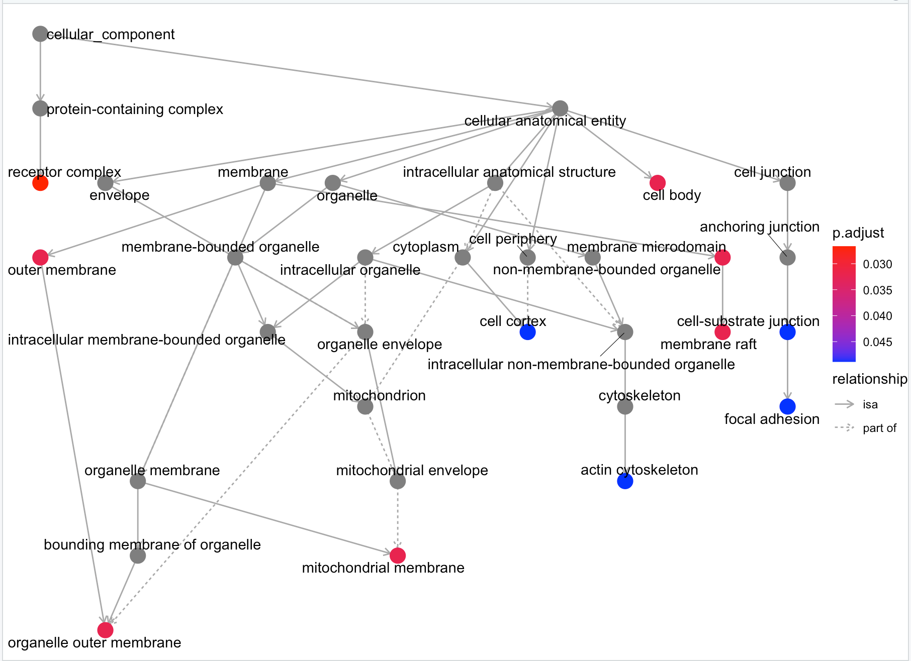
ClustProfiler: Enrichment Map (Network plot)
Notes:
This enrichment map expresses the enriched gene ontology (GO) terms derived from the GO enrichment analysis performed using clustProfiler, as a directed acyclic graph. It organized the terms into a network with the edges being the connections between the group of genes that overlap. It determines the strength of relationships between various pathways and cell functions/structures within the genes.

Slide 8
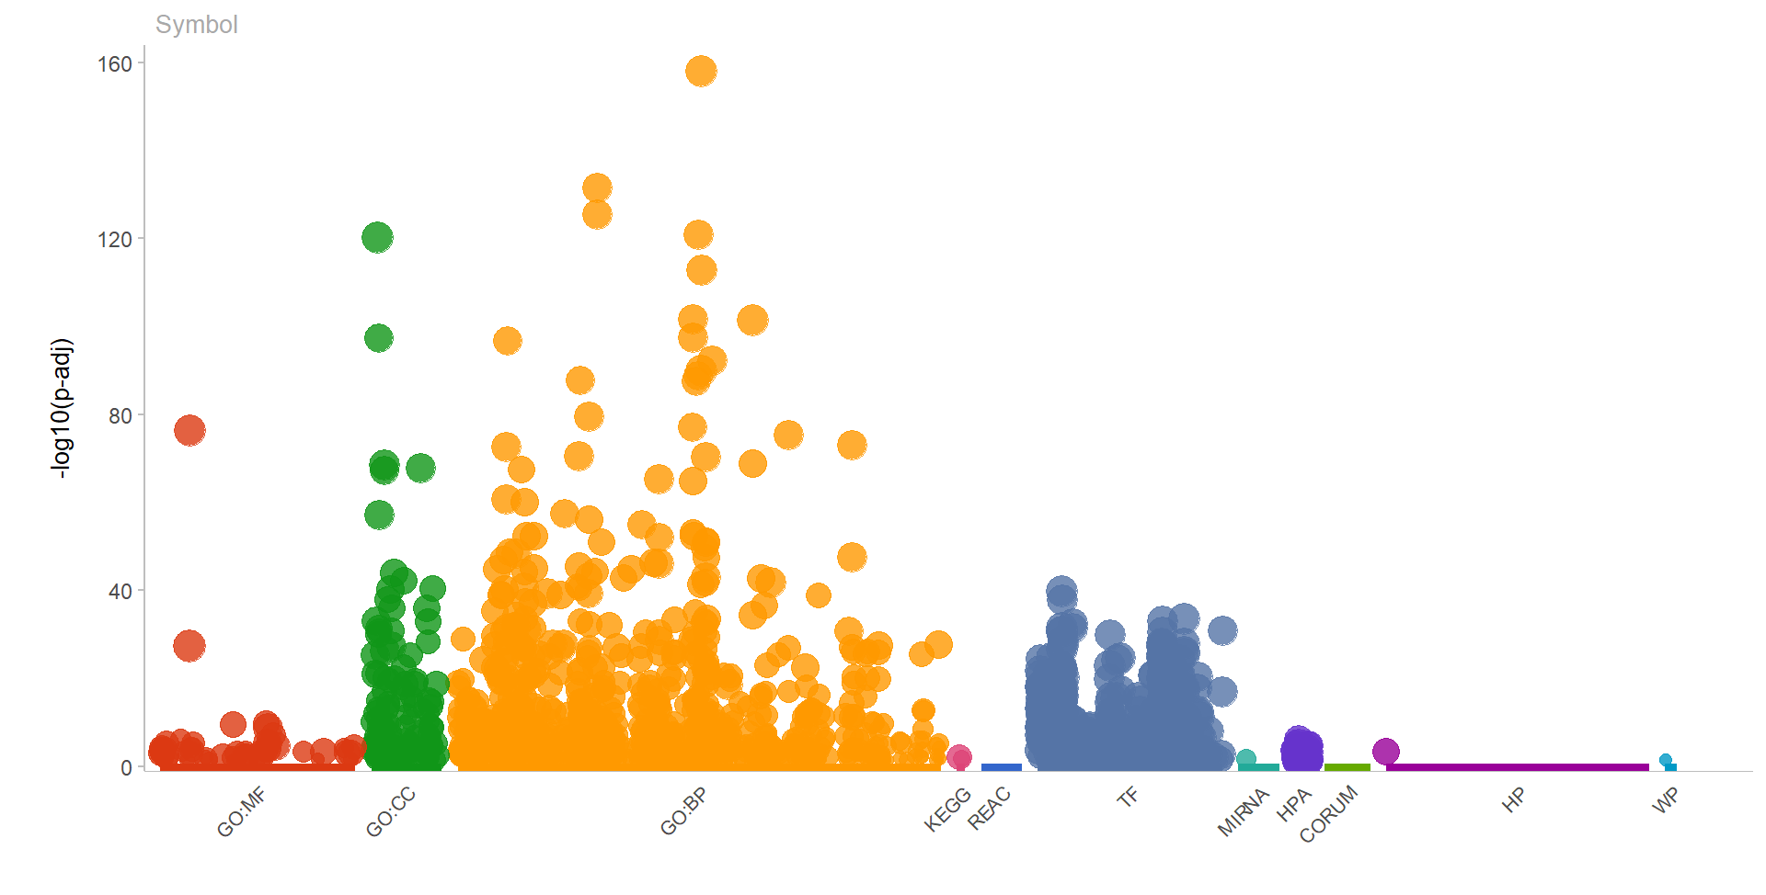
gProfiler2 plot
Notes:
Used gProfiler2 method and gene ontology to create plot. Profiled gene list of HUGO symbols. Most of the genes profiled were from the data source Gene Ontology.

Slide 9
Significance of Results from Differential Analysis and GSEA
Show upregulation of genes that may be associated with the presence of ovarian cancer.
Visualization of the biological interactions that play into the variation of genetic data.
It also shows us relationships and degrees of connected components in order to recognize which part of a gene, when effected, will have the largest effect on the rest of the gene.
Notes:
across gene ontology

Slide 10
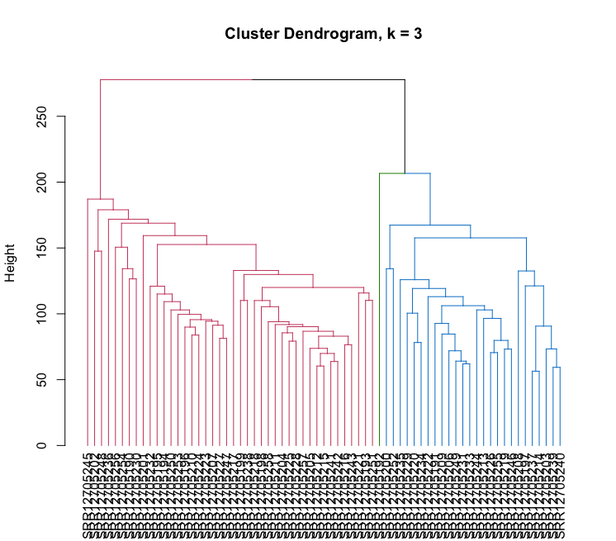
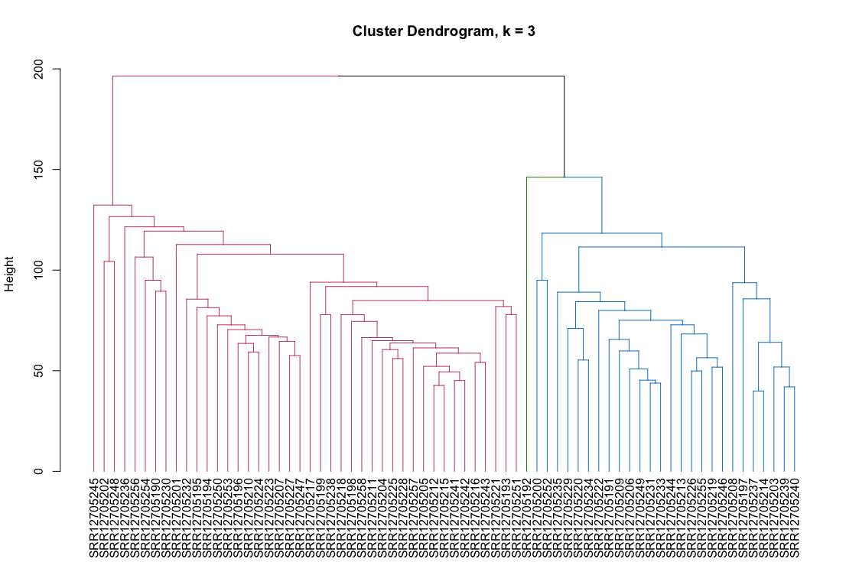
Hierarchical Clustering
Clustering of 10000 genes @ k = 3
3 groups: red, green, and blue
Clustering of 5000 genes @ k = 3
3 groups: red, green, and blue

Slide 11
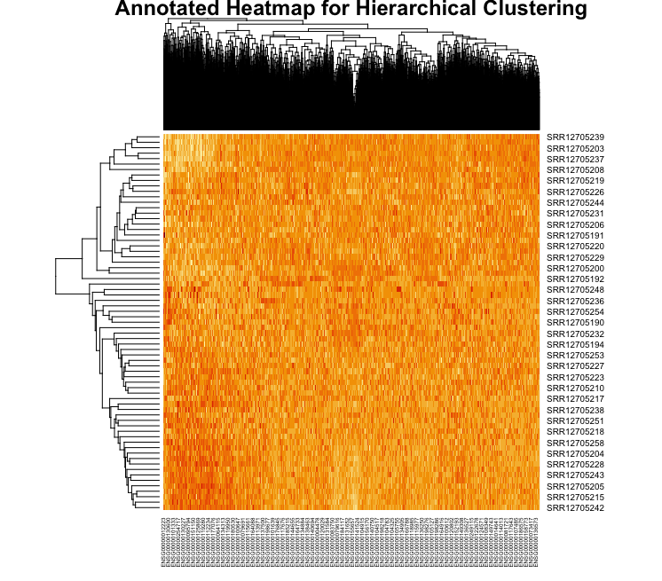
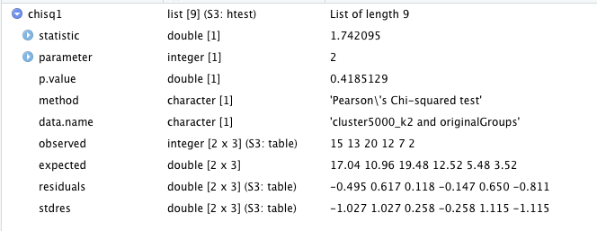
Hierarchical Clustering: Heatmap and Statistics
Notes:
The annotated heatmap contains information regarding the clusters identified by rows of samples in the hclust matrix, along with the clusters identified by the columns of genes in the hclust matrix, creating this cross distribution of both.
These finds are the results of the chi square test of the original groups chose in assignment 1, of cancerous, control, and other (3 groups), agains the hclust algorithm performed for 5000 genes at k = 3, and are somewhat consistent with findings from assignment 1, as shown by the p-value, indicating significance.

Slide 12
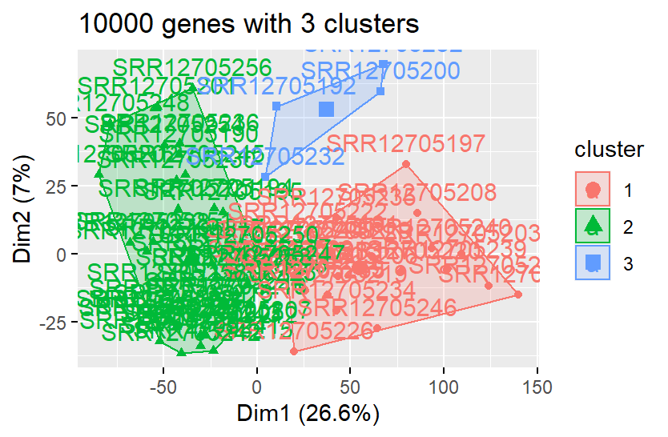
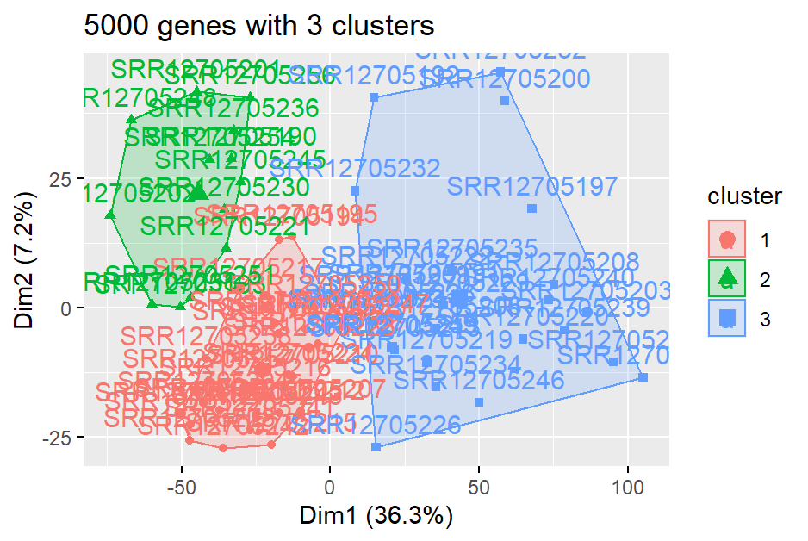
K-Means Clustering

Slide 13
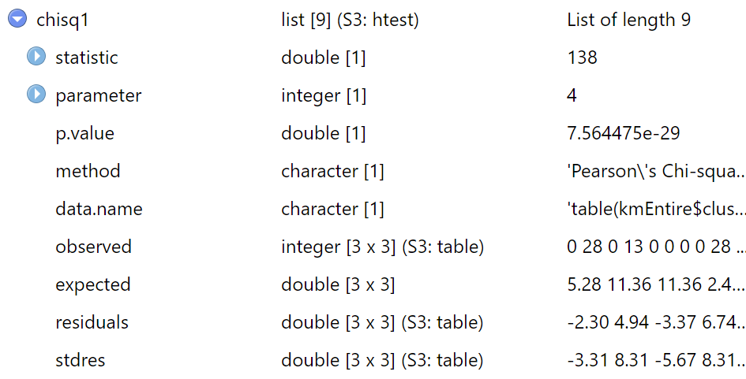
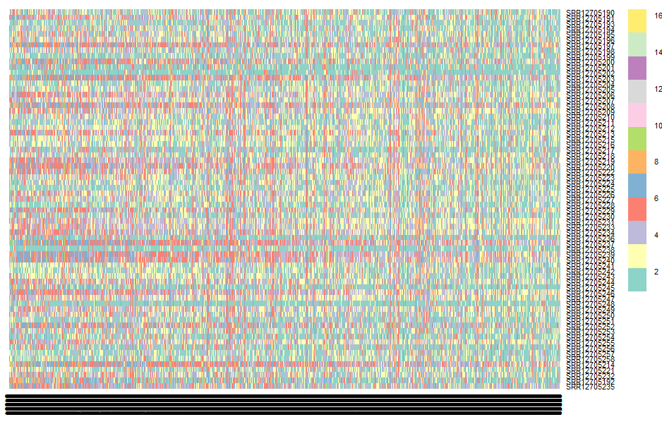
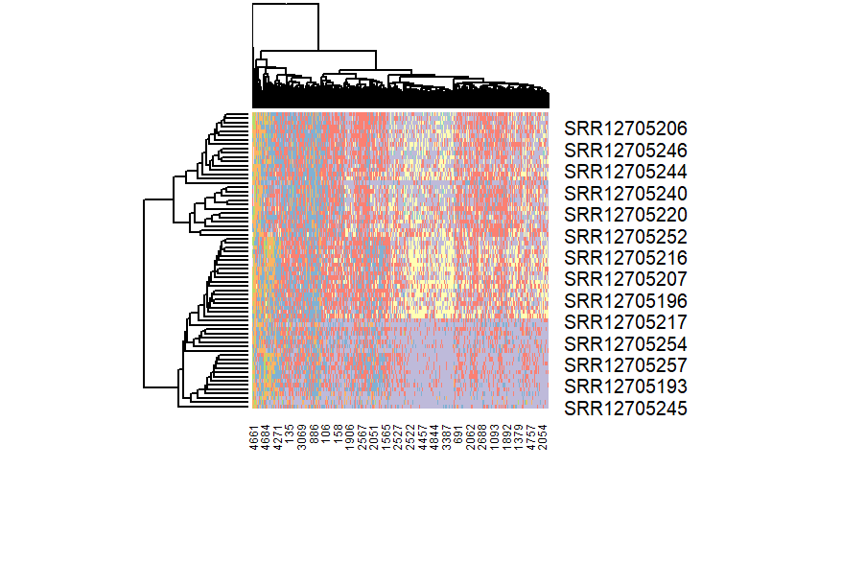
K-Means: Heatmap and Statistics
Notes:
based on 5000 genes
rows: samples
cols: genes
source of error: 16 groups/ clusters instead of 3
p-value: 7.564475e-29

Slide 14
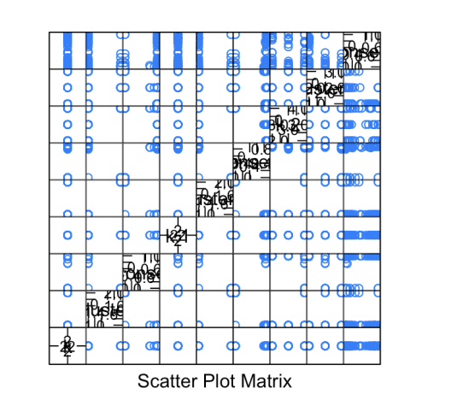
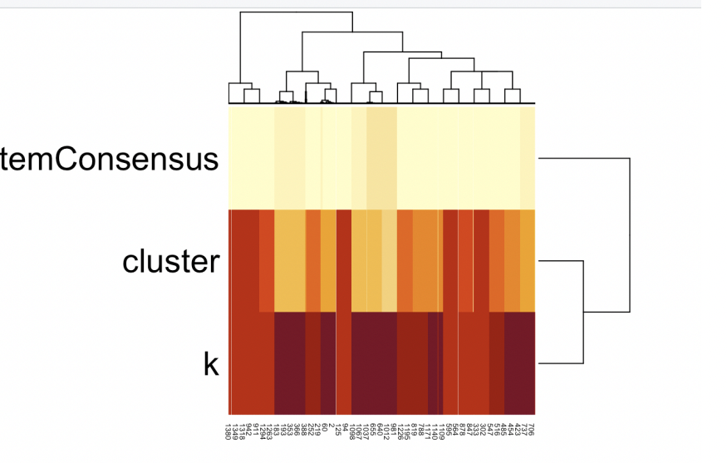
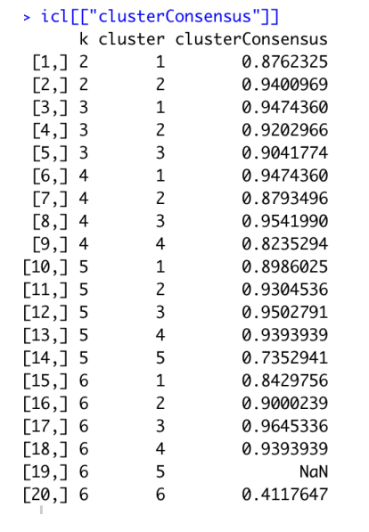
Consensus Cluster Plus

Slide 15
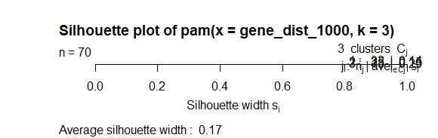

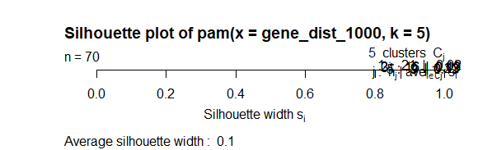
PAM Clustering Algorithm

Slide 16
Statistical Analysis
Clustering gave us a perfect representation of how the cancerous vs. non-cancerous data are segregated from one another. While our data does not show the particular genetic factors that result in these genes being segregated, it is particularly identifiable in K-means and hierarchical clustering that (in a naive manner) there are difference between genes based on their cancer status.

Slide 17
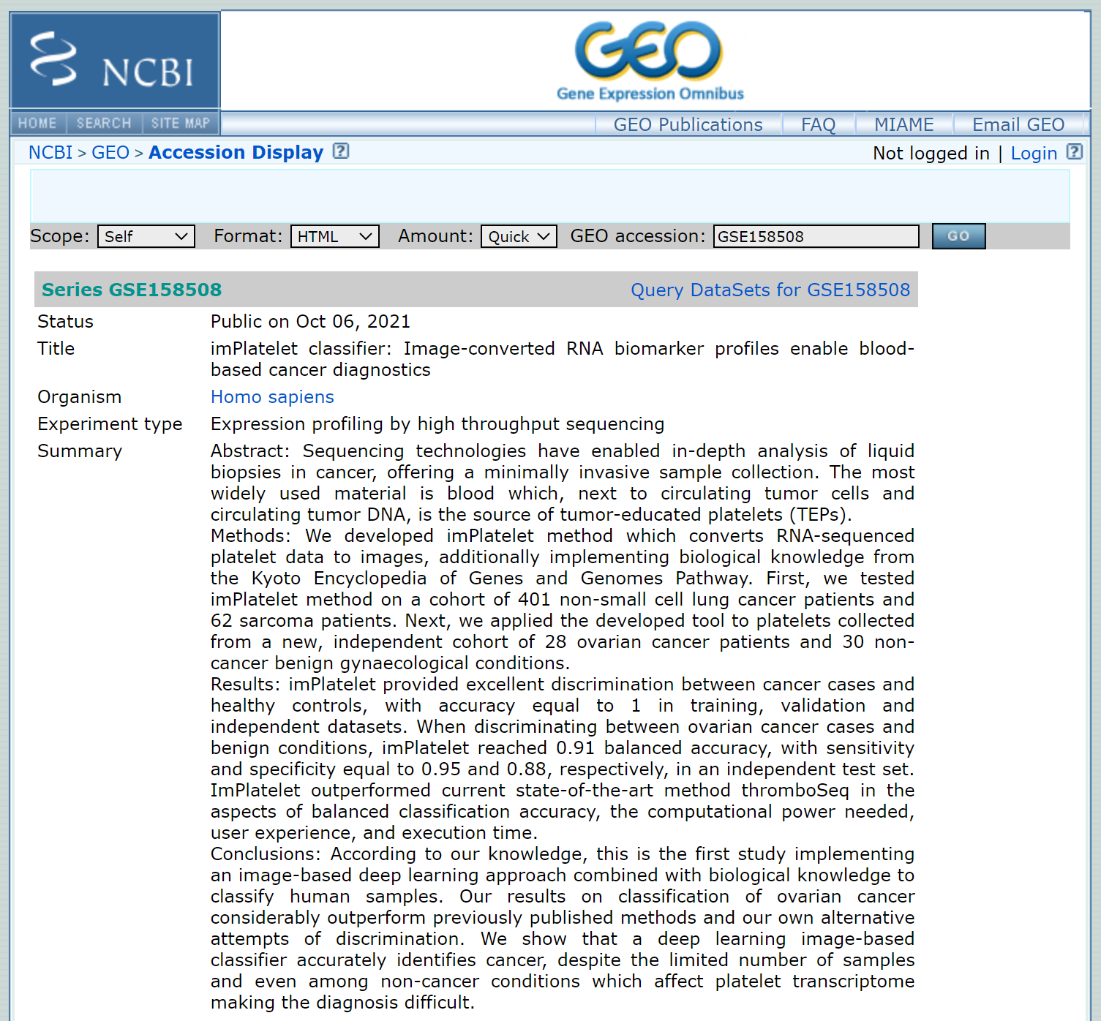
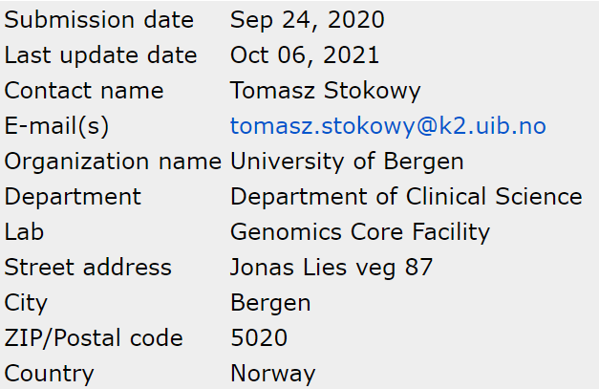
Bioethics

Slide 18
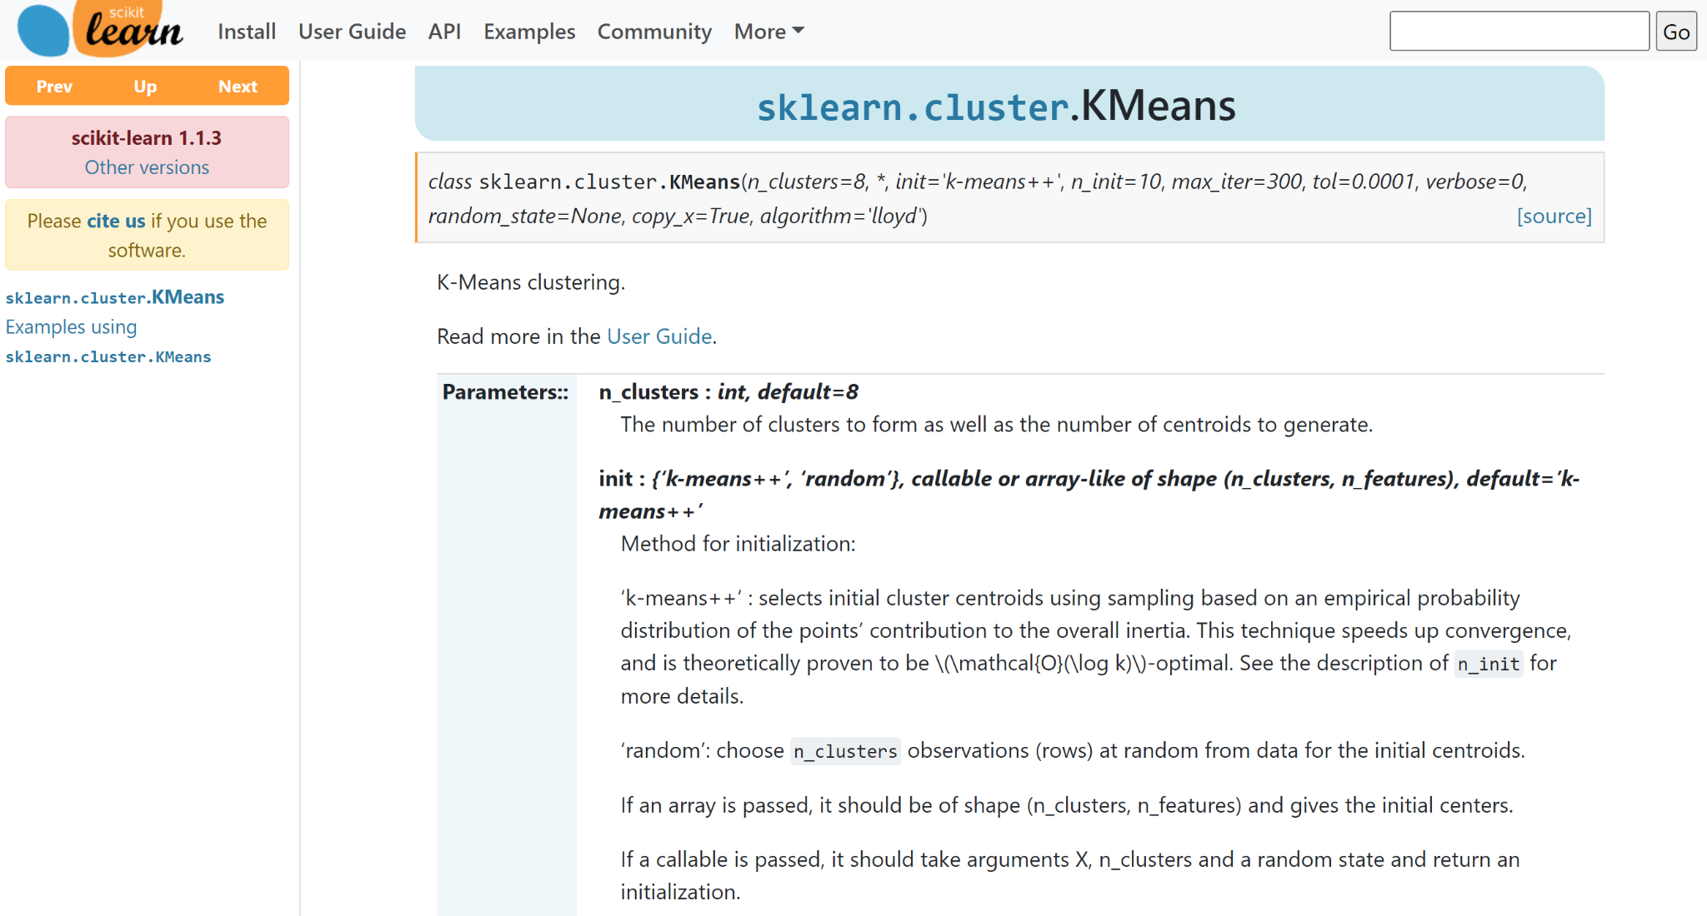
Conclusions & Future Work
Hypothesis: It is possible to identify the presence of ovarian cancer in blood platelets based on gene expression.
Future Work: Consider porting our code into python using the scikit-learn module.

